Slide 1
6AMB Telegram Bot Workshop

Slide 2
Who am I? (Again!)
I’m CPL Siddhartha Bose from 62FMD
Received my bachelor degrees in Computer Science and Economics in 2019 from UCLA
Never coded before 2015
Failed my first programming course and wanted to quit
At the very least my journey should show you that programming may seem daunting but it’s a level playing field, and anyone can succeed with time

Slide 3
Workshop Objectives
By the end of today we will have created 2 telegram bots!
The goal is to get more comfortable with the basics of python while understanding the products we can create with the language
We’ll go through a recap of the introduction course before creating a dummy bot and then hopefully we can create a bot which can be more useful in your lives

Slide 4
Recap Syllabus
Installing Python and using the terminal
Recap of Intro Workshop
Python variables
Python data types
Logical operators
Strings
Booleans
Lists, Sets, Tuples and Dictionaries
Conditional Statements and Loops
Functions

Slide 5
How to Download Python
Unlike the first course, today we will have to download python!
The steps are pretty simple but need to be followed precisely for your given operating system

Slide 6
Downloading Python contd
Visit https://www.python.org/downloads/
Download and install Python 3.9.7 for your given operating system
Windows:
Click the option that asks if you want to add Python to path
Mac:
If you are using a Mac, open up Terminal using finder
type in 'sudo nano /etc/paths’
type in your password
go to the bottom of the file using arrow keys
Add the line '/usr/local/bin/python3'
Press control-x and then 'Y' to exit

Slide 7
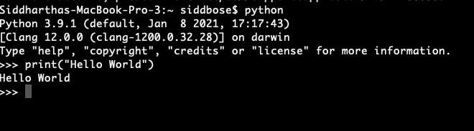
Hello World
So, to start we will create a “hello world” program in python
Type in “python” into your CLI
Then type in print(“hello world”)

Slide 8
Downloading Visual Studio Code
In order to write our code, today we will be using program called Visual Studio Code (created by Microsoft)
Visit this link to download the appropriate version for your computer
https://code.visualstudio.com/download
Once downloaded let’s install the python extension using the extensions tab on the left hand side
Lastly, let’s open up a terminal and get started

Slide 9
Understanding CLI
Command Line Interface is essentially a window into the heart of your computer. It allows you to manipulate files and directories through simple text.
Some useful commands include:
cd – change directory: you can move into and out of folders like this
cd Documents: this will move you into your documents folder
mkdir – make directory: you can create folders like this
touch [filename] – you can create files like this
python3 file.py - you can run python files like this

Slide 10
Python Introduction Recap
Now that we have downloaded Python let’s do a recap of the last workshop
This recap should take the majority of the morning session, followed by the bot creation in the afternoon
Let’s start with variables
How to use them
How to name them
How to output them

Slide 11

Variables Recap
Variables are the building block for python
You can use them to store and manipulate data
Since Python is “dynamically typed” we can initialize variables without explicitly telling the program what type they are
As show above, x is an integer, y is a string and z is a float

Slide 12
Python Data types
We have seen a few data types but let’s go through all of the important ones here
Text: string (“hi”)
Numeric: int (5), or float (5.0)
Sequences:
List: [1,2,3]
Tuple: (1,2,3)
Mapping:
Dictionary: {“name”: “Sidd Bose”, “rank”: ”CPL”}
Boolean:
True, False (capitalization matters here!)

Slide 13

Casting Variables
Although variables are dynamically typed in Python, we also have the concept of casting
Using casting we can ”tell” the program what type we want a variable to be
As shown above, 5 can be represented in different ways if we cast it

Slide 14
Naming Variables
Naming variables is relatively simple in python but we must follow a few rules:
The variable must start with a letter or underscore
The variable can only contain alphanumeric characters and underscores (A-z, 0-9, and _ )
Capital letters and lowercase letters refer to different variable

Slide 15
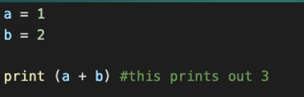

Inputting and Outputting Variables
Outputting variables is simple using the print() command
Similarly, inputting variables uses the input(prompt) command as follows, where prompt is the user prompt for input

Slide 16
Logical, Arithmetic and Comparison Operator Recap
Having variables is one part of the battle, but often we want to compare, contrast or compute!
In order to do so we can leverage different operators
Logical: Checking if two or more statements is true
Arithmetic: Using variables to do math
Comparison: Comparing the magnitude or equality of variables

Slide 17
Logical Operators
These operators show how python leverages English
and, for example x < 5 and x < 10
Returns True if both statements are True, False otherwise
or, for example x < 5 or x < 4
Returns True if either statement is True, False if both are False
not, for example not(x < 5)
Returns True if the inside statement is False, True otherwise

Slide 18
Arithmetic Operators
Most of these should be very intuitive for all of us
These operators work between two numeric values
Addition (+), for example x+y
Subtraction (-), for example x-y
Multiplication (*), for example x*y
Division (/), for example x/y
Modulus (%), for example x % y (where x % y gives the remainder)
Exponentiation (**) for example x**y (which is x^{y})

Slide 19
Comparison Operators
These are also intuitive, but the syntax is key
Equal (==), for example 5 == 5 is True
Not equal (!=), for example 5 != 5 is False
Greater than (>), for example 8 > 7 is True
Greater than or equal to (>=), for example 6 >= 7 is False
Lesser than (<), for example 7 < 8 is True
Lesser than or equal to (<=), for example 7 <= 6 is False
In each case, the result of this operator will tell you if the comparison is True or False
For example, x = 2, y = 3, then x == y returns False and y >= x returns True

Slide 20
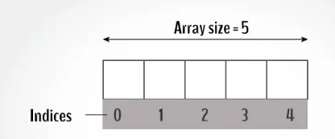
Strings Recap
As we know, a string is a word or character encapsulated in quotations: “var” like this
Since a string is an array of characters, we can access elements by indexing as shown below
For example, if x = “hello”, then x[0] is “h”

Slide 21
String Methods
The most important string methods are as follows (using x = “abc” and y = “defg” as examples):
len(x)-> will return the length of x, or 3
x[1:3] -> will return “bc” as a sliced string (format is [first index: last index +1])
x+y-> will return “abcdefg”
For more string methods, visit:
https://www.w3schools.com/python/python_strings_methods.asp

Slide 22
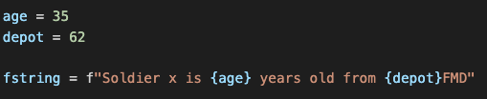
F Strings
In Python F Strings allow us to insert variables into a string
The syntax is as follows: f”string {var} string”
This allows us to concatenate a string more naturally

Slide 23

Booleans and how to use them
If you recall, Booleans are simple True and False values
When we use logical and comparison operators, Booleans are the result
You can evaluate statements and have them print out as True or False

Slide 24
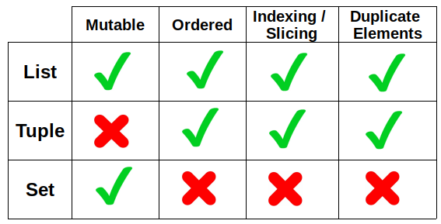
Lists, Sets and Tuples
Lists, sets and tuples are all ways to hold multiples pieces of data at the same time
The table below explains the difference between the 3 data types:
Mutable = changeable
Ordered = objects stay in a certain order
Indexing = you can access a value like in a string
Duplicates = you can have multiple of the same value
Examples:
List: [1,1,2,3,4], we can add and remove values
Set: {1,2,3,4} we can add and remove values but we can’t access via indexing
Tuple: (1,2,3,4,4), we cannot add or remove values but we can index

Slide 25
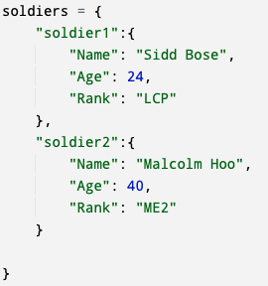
Dictionaries Recap
Perhaps the most powerful data type mentioned thus far, dictionaries use ‘keys’ to index into them
For example, a dictionary could be instantiated as follows:
This is an example of a nested dictionary
Essentially the dictionary ”soldiers” contains:
Dictionaries for each soldier and those contain:
Name, age, rank
Soldier1’s rank can be obtained as such
soldiers[“soldier1”][“Rank”]

Slide 26
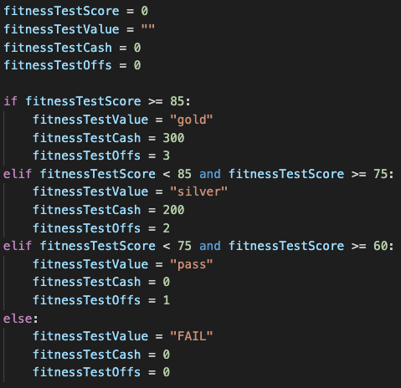
Conditional Statements Recap
If you recall, conditional statements use logical operators to check certain conditions and execute different blocks of code
The format is:
If, elif …., else
As we see on the right, if a condition is met, a certain block of code is executed
If no conditions are met, only the else block is executed
We need to ensure that indentation is correct in if else blocks otherwise python will not run

Slide 27
Loops: While and For
Looping is the best way to run a certain piece of code repeatedly
In python the two most common forms of loops are while and for loops
For the most part, both can be used interchangeably and are up to the programmer to choose which one suits them or the task best

Slide 28
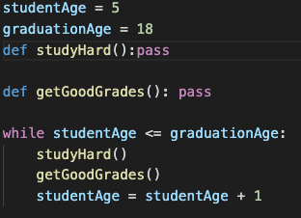
While Loops
Looping is critical in control flow because it allows us to do the same set of tasks repeatedly without having to explicitly write them out
A while loop is much like it sounds
While a certain condition is met do a job
For example, in English we might say:
While you are in school, study hard and get good grades
The following is an example of this sentiment

Slide 29


For Loops
For loops are very similar to while loops but in python they allow you to write code in a more concise manner
For example, if we want to print out the list from the previous section, we would write it as such
You can obviously also use for loops just like while loops where you manually iterate (the range function iterates through values for you):

Slide 30
Functions
The last part of today’s recap is functions
Functions allow for a task, or a block of code to be encapsulated
This code is only run when it is ”called”
Functions can take inputs, usually as ”parameters” and can output either as print statements or as return values as we mentioned earlier

Slide 31
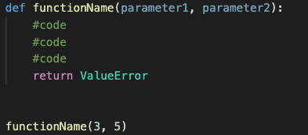
Functions Contd.
In order to declare a function the syntax is as follows:
A function can have zero or more arguments/parameters
This information can then be used or manipulated and then returned
In order to ”call” a function, we simply type the name of the function with the relevant parameters as shown above

Slide 32
Recap Over!
Okay, recap was a lot of information but it will be crucial for the next part of the day
For the second half of the workshop we will first work on first creating a simple bot that we can interact with
Hopefully by the end you will have the tools to use code from our last workshop to build a slightly more useful bot

Slide 33
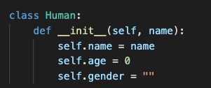
Classes
An important concept in ”object-oriented programming” is classes
Classes essentially define an object and its characteristics
For example: A human has a name, age and gender
In a class we can write it as follows:
Def __init__ is a function called a constructor. It will create a new object

Slide 34
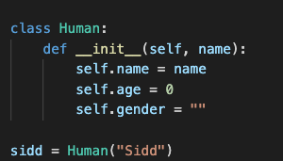
Classed Contd
In order to create a new class using the def init function we do the following
Since the init function requires a name variable to set the name characteristic, Human(“Sidd”) is the way to create the class

Slide 35
Creating a Telegram Bot
Telegram is an app most of us are familiar with
Like whatsapp, it is a free instant messaging platform but it has the unique benefit of allowing customized “bots” to run on the application
These bots are lightweight applications that have quite a range of use-cases

Slide 36
Telegram Bot Contents
Importing telegram and telegram.ext
Getting the API Key
Understanding the parts of the bot
MessageHandler, CommandHandler, ConversationHandler, Keyboards
Interacting with our first bot
Creating a dummy bot

Slide 37
Goal of Dummy Bot
The goal of our dummy bot is to take our name, age and gender as input and output the stored information
We will use all the techniques that will be useful to create more interesting and complicated bots
Let’s begin!

Slide 38
Installing and Importing Libraries
In most python projects, the first step will be to install and import all relevant libraries
To install a library we can use the ‘pip’ command in our terminal
pip3 install python-telegram-bot
Now let’s create a new python file
touch dummy.py
Open the file
Now to import the libraries we need, type the following:

Slide 39
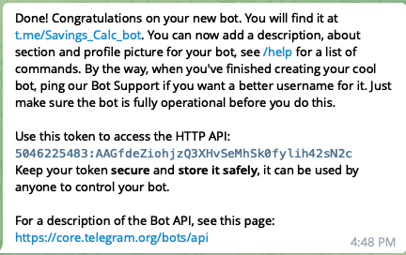
Getting the API key from Telegram
This part is less programming, more logistics
On telegram, we can access the BotFather account
By using the /newbot command, we can follow a couple of steps and get a new bot API Key
An API key is essentially a way to access and identify our bot
The final message looks something like this

Slide 40

Message Handler
Before we get into the crucial stuff, we need to talk about message handlers
Essentially these are objects that allow us to:
1. choose what kind of information we want our functions to accept (images, locations, text)
2. Define which function will trigger based on a given input
A Message handler looks like this:

Slide 41

Command Handler
Much like the message handler, the command handler allows us to create functions that trigger when a telegram command is used
Commands in telegram are usually in the /command format
To create a command handler we can do the following:
Where ‘start’ is the command, and function_name is the function

Slide 42
Conversation Handler
To build the bot we need to understand one fundamental concept: the conversation handler
Essentially, it is an object (like the class we created earlier) that holds the following information
Entry points: how we can access the bot (CommandHandler)
States: steps within a bot’s functions (MessageHandler)
Fallbacks: what to do when things go wrong (CommandHandler)

Slide 43
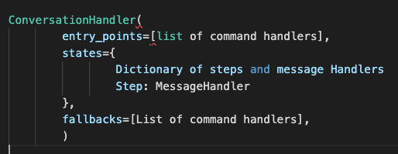
Conversation Handler Contd
To create a command handler is a bit specific, so let’s look at the general format

Slide 44
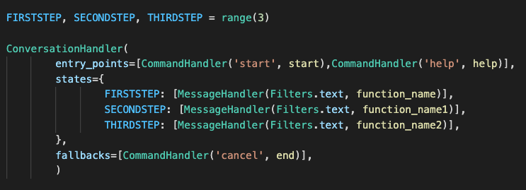
Conversation Handler Contd
More specifically we can have the following:
Where FIRSTEP, SECONDSTEP and THIRDSTEP are simply mapped to 0,1,2 using the range function

Slide 45
Human Class
So let’s start by creating a Human class
We need the human class to have:
Name
Gender
Age
So we define it as shown in the class slide

Slide 46

Humans dictionary
The method I like to use to hold information in telegram bots is a dictionary
As we learned, we can index into a dictionary however we want and in this case every user has a unique identifier (their chat id)
Therefore, if we create a dictionary, we can use chat_id to store information for every user
The dictionary can be created as above

Slide 47
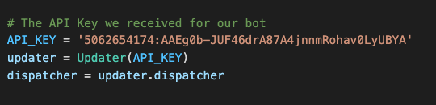
Setting Up the API Key
Before we write our functions, we need to let Telegram know what code to run using our API key
We do this by setting up an “Updater” as follows
Again, ensure that the API key is what you got from Telegram

Slide 48
Creating Our First Functions
In order to start using the bot we must have at least 2 functions.
Start
Main
The start function will allow us to have some functionality and the main function will let us actually run the code!

Slide 49

Writing the Start Function
For each ‘state’ we will initialize functions as follows:
Def function_name(update_obj, context)
Update_obj gives us message meta data (text, chat id etc) and context is the state of the bot at any time
Although we can’t run it yet, here we see an important function
Update_obj.message.reply_text(“text”) will send a message to the user!

Slide 50
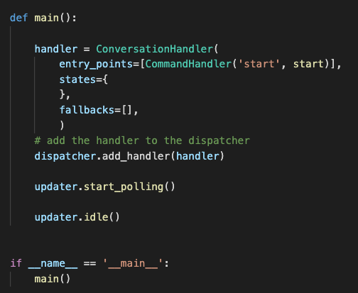
Writing the main function
The main function is essentially the engine of this project. It takes the Conversation handler and allows us to run the bot!
In most python projects you will notice this main() and if __name__ format. Essentially it allows us to run the main function even if we have many files
In this function we see:
ConversationHandler
Dispatcher.add_handler
Updater.start_polling
Updater.idle

Slide 51
Breaking Down the Main Function
We’ve spoken about the ConversationHandler already but let’s look at the other couple of lines
Dispatcher.add_handler:
This adds our conversation handler to the bot Ensures that when we run the bot all the relevant functions are present
Updater.start_polling():
Polling is a way to access the bot via the internet
Updater.idle():
Tells the bot to basically wait for input

Slide 52
Running the bot
Let’s run the bot now
If we type in “python3 dummy.py” and click enter the bot should start
You can then go on telegram desktop or the application and type in /start
This should lead to the bot replying!

Slide 53
Now What?
This process that we just went through is important in every project; creating a prototype
Essentially it is the smallest version of the project that we can say “does something”
Now that we have a function, let’s make a few more that correspond to the following flowchart!
Ask for gender
Ask for age
Ask for name
Output information

Slide 54


How do we move between states?
This is where the concept of a return value and the ConversationHandler come into play
For every state we want to move between, we need to add a message handler to the conversation handler
A habit programmers have here is to assign each state a name and a number to access later on
This line is the same as

Slide 55

Adding a second function
Now let’s add a second function that echoes our message
As we mentioned before in our start function slide, we can use update.message.reply_text() to reply to the user
In addition, we can use update.message.text to grab the information that the user has just typed in

Slide 56
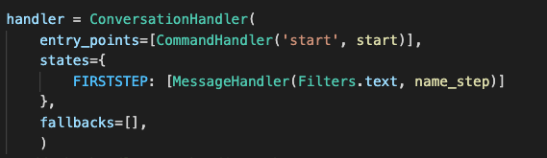
Moving from start to the second step
Now that we have two functions we need to update the first function and the ConversationHandler
We add a state and message handler to ConversationHandler as follows:
Then we add the line “return FIRSTSTEP” at the end of the start function

Slide 57


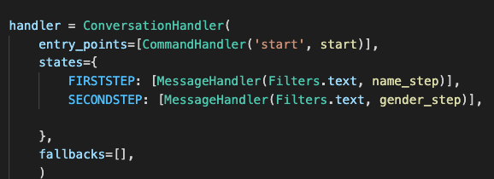
Third Function
Let’s finish the functionality by adding a third function that again simply echoes the text received!
1. Create the function
2. Create a state for the function
3. Add the state to the ConversationHandler
4. Add “return SECONDSTEP” to the name_step function

Slide 58
Taking stock of where we are
So now we have 3 functions, they don’t do much but they interact with the user
Let’s start asking questions we need answers to and storing information

Slide 59
Storing Information
Storing information is essential to using a bot, and this means we need data structures
We mentioned two specific data structures earlier: classes and dictionaries
class Human:
humans = {}

Slide 60
Format of each function
The common format for a function in a Telegram bot is:
Store the information we received from the previous step (if not first step)
Manipulate information if needed
Set up for next function
Reply to user
As such let’s redo the start function

Slide 61
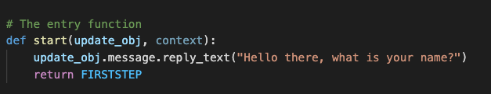
Redoing Start Function
Now that we have the basic format down, let’s follow the flowchart and redo the start function
First we need to ask the user for their name
All we have to do is change the prompt!
Ask for gender
Ask for age
Ask for name
Output information

Slide 62
Redoing the second function
Let’s follow the format more closely now
Store:
We need to store the information (name) into our class and dictionary
Manipulate:
There isn’t any manipulation being done here
Set up:
We don’t need to set up for the next function either
Reply:
We can now reply and ask for age!
Ask for gender
Ask for age
Ask for name
Output information

Slide 63


Coding out the second function
Store:
Here we grab the message text, create a Human object, store the object in the dictionary
Manipulate: N/A
Set Up: N/A
Reply:

Slide 64
Post Second Function
Now that the second function is written, we have the third prompt to send to the user
Here, since we have two genders we will use a Keyboard
Ask for gender
Ask for age
Ask for name
Output information

Slide 65
Keyboards
For those of us who have used Telegram, we are probably familiar with Keyboards
Essentially they replace the QWERTY keyboard we are used to with custom buttons
Each keyboard is a List of Lists!
The format is as follows:
Creating a keyboard involves a few steps so let’s go through them one by one

Slide 66
Keyboards Contd
Steps are as follows:
Create the list of buttons
\
Create a keyboard markup
Add the keyboard to the reply message

Slide 67
Creating the third function
Store:
Like the second function we need to store the information from the previous function
Manipulate: N/A
Set Up:
This is where we create the keyboard
Reply:
Reply with the new keyboard

Slide 68

Coding up the third function
Store:
Manipulate: N/A
Set up:
Reply and return:

Slide 69
The End Function
Now that we have created our last function that prompts the user we need 1 more function to do the following
1. Output the information
2. End the Conversation
First things first let’s add a final step to the ConversationHandler
Ask for gender
Ask for age
Ask for name
Output information

Slide 70
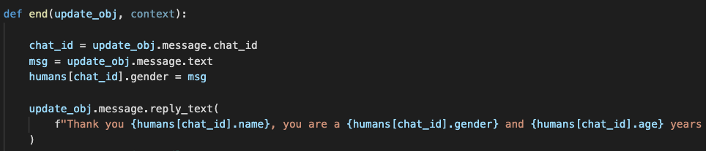
The End Function Contd
All we have to do now is access and output the information we have gathered
Since all the information is held in the dictionary as a class, we can simply access the dictionary and then reply
The last thing we have to do is add a return statement that ends the conversation

Slide 71
Are We done?
Yes and no
So when it comes to applications where users are inputting information, we always want a backup plan
This is where try/except blocks come into play
Essentially at every function we want to “try” the code and if something unexpected happens we have to handle it in a predefined way
As I’ve mentioned before, there is nothing worse than undefined behavior!

Slide 72
Except Function
We will just create a quick function called “Error” which will trigger if something goes wrong.
All this function will do is reply “there was a problem, press /start to start again!” and then end the conversation
In more complex fallback functions we can tell the user the actual issue but for now this is good enough

Slide 73

Coding the Except function

Slide 74
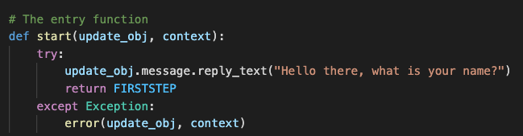
How to use try/except blocks
For every function we will put a ”try:” as the first line, and then after the code an except line
For example here is the start function

Slide 75
Dummy Bot Complete!
This brings us to the end of our second workshop and this time you all have homework (which you hopefully want to do!)
I will give you all a copy of the Savings Calculator code from the first workshop and a format for how the bot should flow
https://github.com/siddbose97/pythonWorkshop/blob/master/savings_calculator.py
You can find the code for my dummy bot at the following link as well (the API key is removed, so input your own!)
https://github.com/siddbose97/Telegram_Workshop/blob/master/sandbox.py

Slide 76
Savings Calculator Bot Format
How old are you?
Would you like to calculate Total Savings or Monthly Savings?
Calculate and Output Monthly Savings
Calculate and Output Total Savings

Slide 77
Conclusion
Today’s workshop was much tougher than the first and I’ll be the first to admit that applying programming knowledge is never easy
Although Google is always your best friend on this I’ll be available as well if you have questions so please reach out to me via Whatsapp or email at siddbose97@gmail.com!

